Slide 1


Blockchain Security
Blockchain Network Security, Wallet Security, Cold Wallets, The DAO Hack, Parity Hacks
Sevgin Mustafov
Blockchain Developer & Course Developer
Academy School of Blockchain
http://kingsland.academy

Slide 2



Table of Contents
Vector of Attacks
Blockchain Network & Consensus Security
Client Side Security & Wallet Security
Famous Blockchain Disasters

Slide 3

Vector of Attacks
Cryptography, Blockchain Networks, Consensus, Wallets, Scam, Smart Contracts

Slide 4
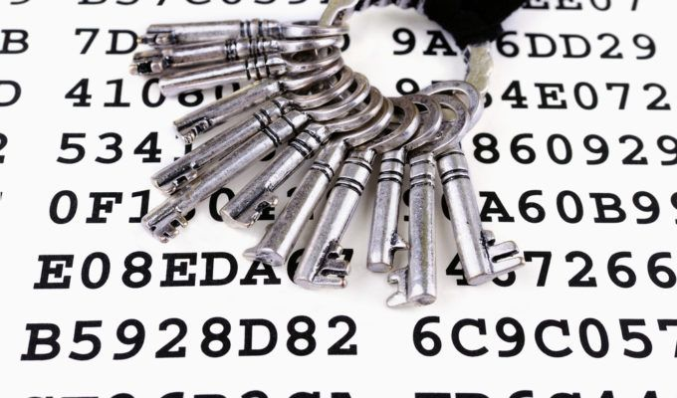
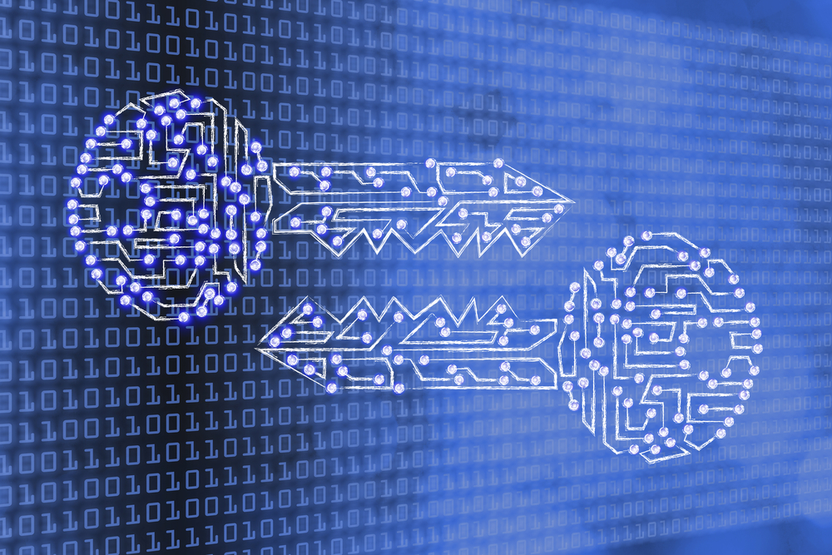
Attack the Cryptography
ECDSA attacks
Reused / unsafe random in signatures
Random generator attacks
Collision attacks (hash function attacks)
Side-channel attacks
E.g. analyze the CPU power consumption
Brute force attack (BFA) to find a key
Quantum computing attacks
ECDSA is not quantum-resistant!

Slide 5


Attack the Blockchain Network
Networking attacks
Eclipse attacks / Sybil attacks
Denial of Service (DoS) attacks
Timejacking attacks
Consensus algorithm attacks
51% attack → double-spending
Transaction replay attack

Slide 6
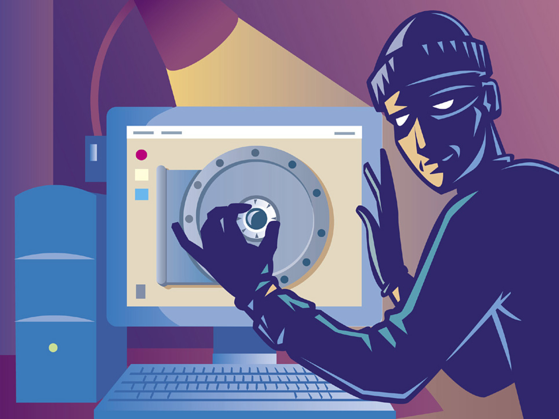
Attack the Wallets
Malware (trojan horses / viruses / backdoors / keyloggers)
Can steal wallet private keys
Scam / phishing site / fake app
Can steal wallet private keys
Lost key → locked funds
Attacking the wallet backups
3rd party hack, e.g. a site / app / library
Server machine hack, e.g. the Coincheck exchange

Slide 7

Smart Contracts: Well Known Attacks
Reentrancy attack
Cross-function race conditions
Integer overflow / underflow
Replay attack
Reordering attack
Short address attack
Timestamp dependence attack
Denial of Service (DoS) attack
with (unexpected) revert
with block gas limit
Forcibly sending ether to a contract

Slide 8
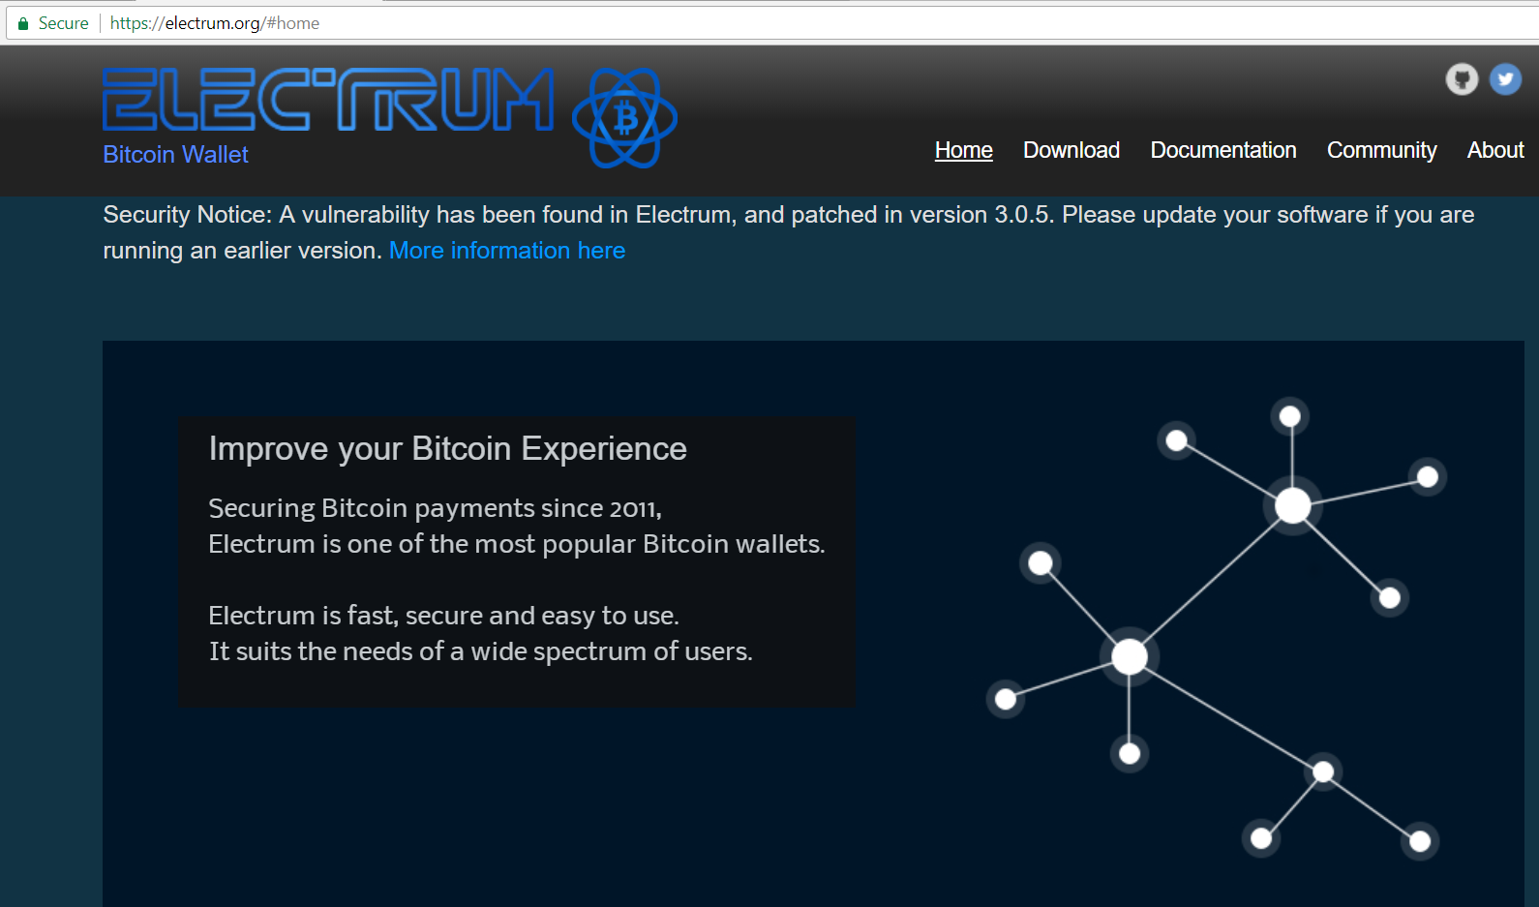
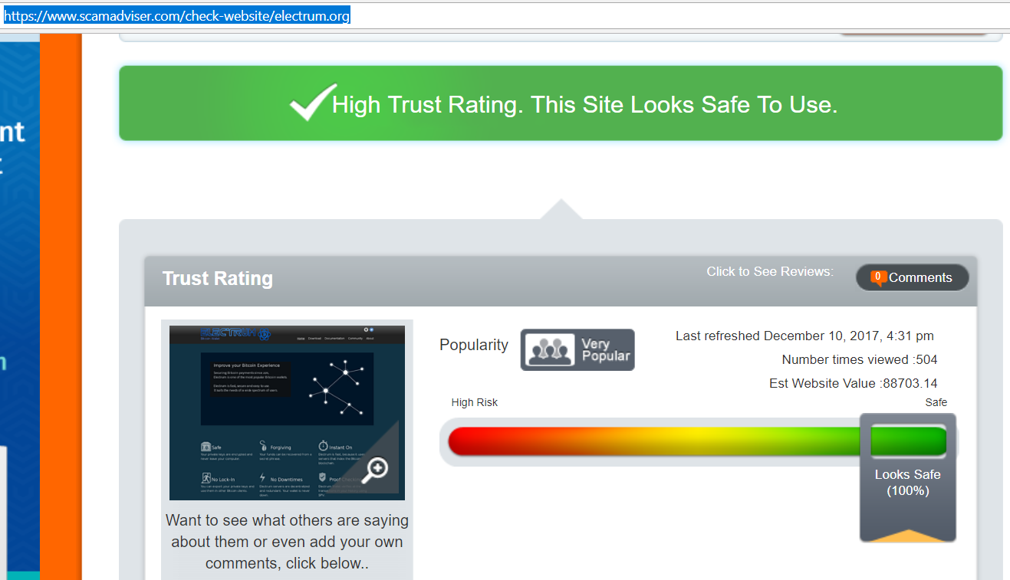
Phishing Site Example: Electrum Wallet
Genuine site: https://electrum.org
Scam advisor check: https://www.scamadviser.com/check-website/electrum.org

Slide 9
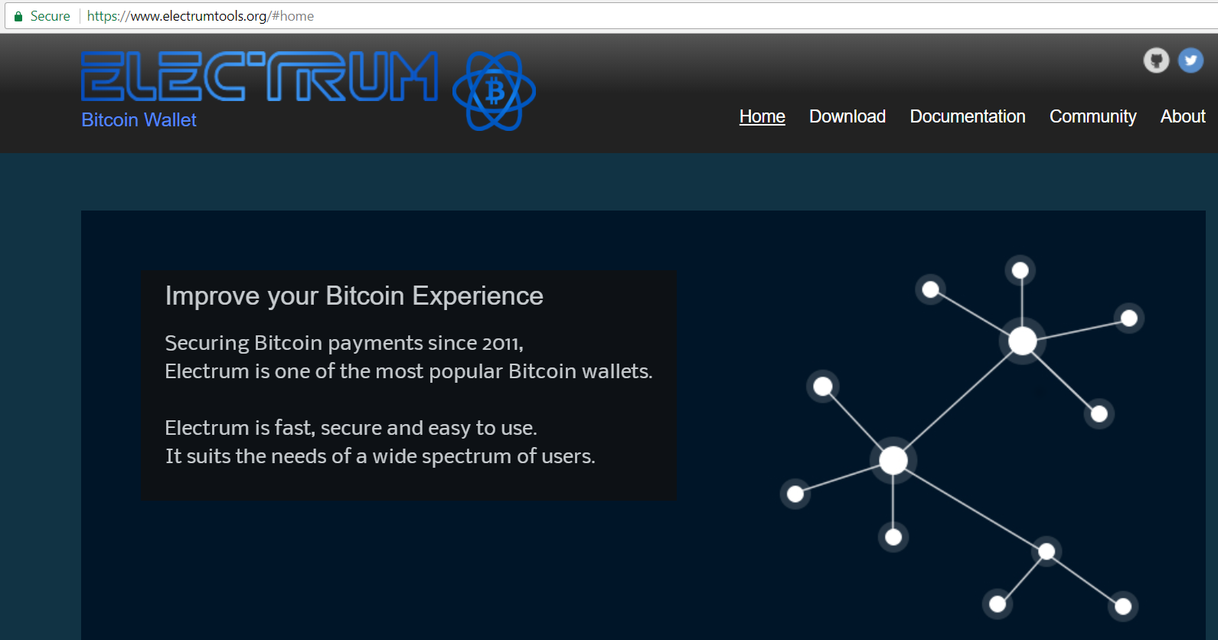
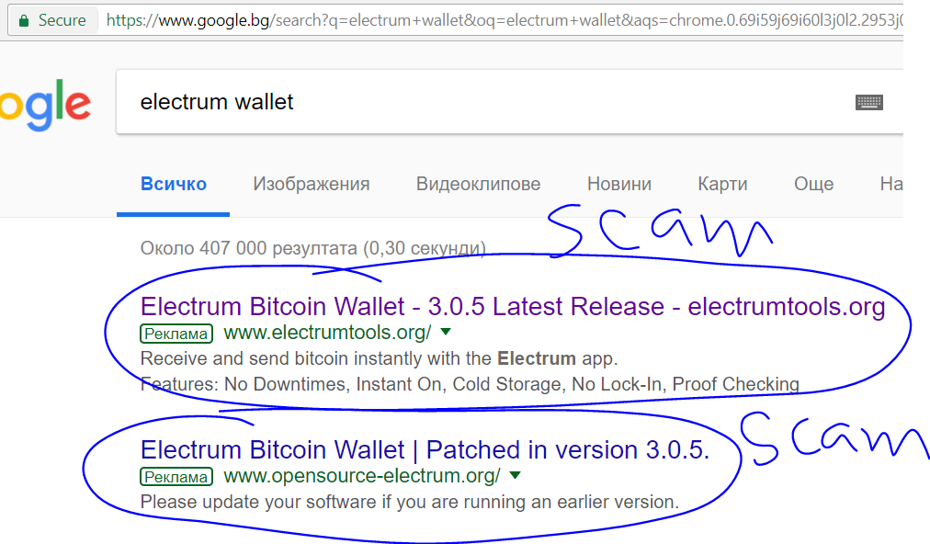
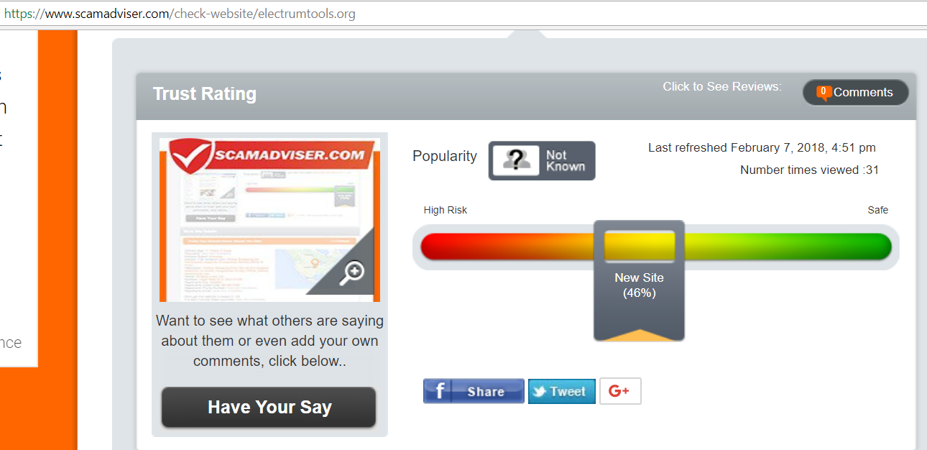
Phishing Site Example: Fake Electrum Wallet
Scam site: https://electrumtools.org
Scam advisor check: https://scamadviser.com/check-website/electrumtools.org

Slide 10

Blockchain Network Security
Security by Blocks, Chaining and Cryptography

Slide 11

Security by the Blocks
Blockchain
Chain of digital “blocks” holding records of signed transactions
Each block connected to blocks before and after
Difficult to tamper
Secured through cryptography
Transactions are signed
If something is altered → the signature will become invalid

Slide 12

Security by the Blocks (2)
Decentralized and distributed across peer-to-peer networks
Continually updated
Kept in sync between all nodes
Don’t have a single point of failure
Cannot be changed from a single computer
Require massive amounts of computing power
51% attack

Slide 13
Public and Private Blockchains
Public (permissionless)
Use computers connected to the public Internet
Any computer on the internet can join the network
Not good choice for enterprises
Designed around the principle of anonymity
Transactions are verified through “mining”
Private (permissioned)
Only permit known organizations to join
They form a private, members-only “business network”
Use identity to confirm membership and access privileges
Transactions are verified through “selective endorsement”

Slide 14
Public and Private Blockchains: Security
Public (permissionless)
51% attack
→ revert transactions
→ double spending
Sybil attack
Denial of Service (DoS) attack / DDoS / spam transactions
Network difficulty manipulation attack
Private (permissioned)
Join unauthorized member, e.g. though hacked server's credentials
Send unauthorized / fake transaction, e.g. using hacked user
Unauthorized data access / leak of confidential data
Consensus algorithm atttacks

Slide 15

Uses of Blockchain to Enforce Security
The protection of sensitive records and authentication of the identity
Enhancing structural security of IoT devices
Securing internal communications
Privacy and security of digital chats
Increase security on three fronts:
Prevention of identity theft
Protection against data tampering
Protection of critical infrastructure

Slide 16

Client Side Security
Cold Wallets, Exchanges, Threats

Slide 17

Different Level of Security
Level of Security depends on:
Type of wallet
Method of Authentication Used
User’s behavior
Security issues:
Server-side stored private and public keys
Prone to hacker attacks
Exposition to counterparty risks

Slide 18

Mobile Wallets
Relatively high risk of information being lost or stolen
Security may be increased through:
Screen lock
Applock
Phone encryption
Phone passwords / PIN codes

Slide 19

Desktop Wallets
Security depends on behavior of account owner
Visiting untrusted web resources
Having a designated device solely for the use of the wallet greatly increases its security

Slide 20
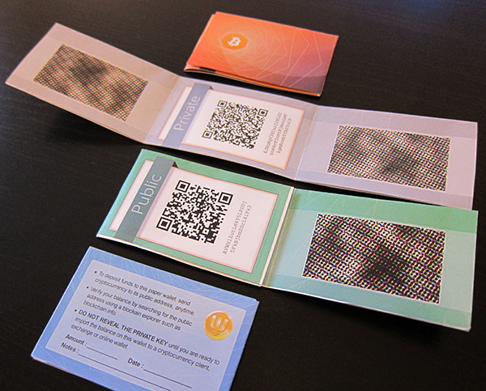
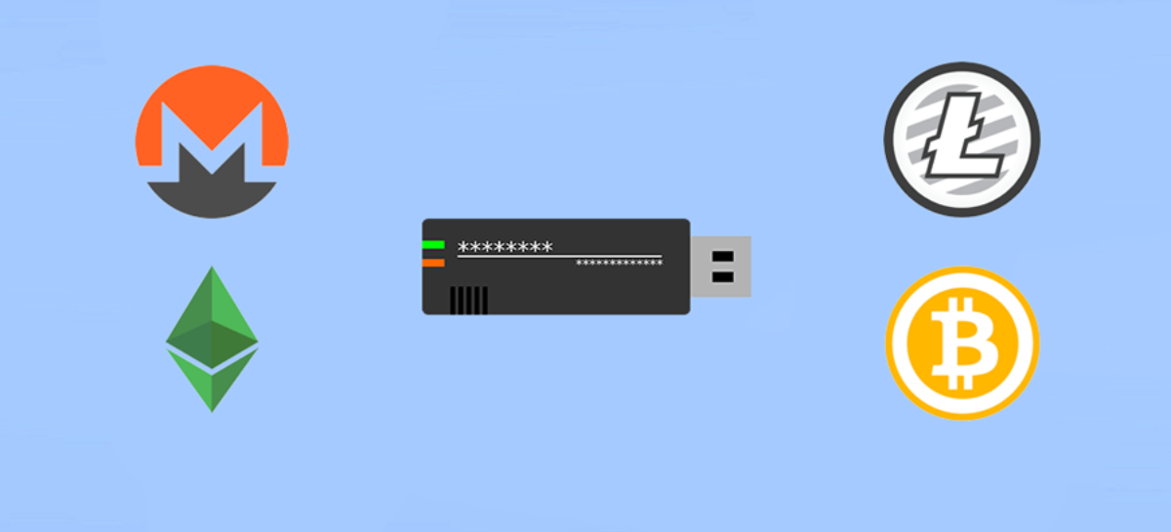
Offline Wallets (Cold Wallets)
Paper wallet
Hardware wallet
Relatively high security
Stored offline
No other connections
Greatly reduces the risk

Slide 21



General Wallet Security
Verify your email
Two-step verification
Backup phase

Slide 22
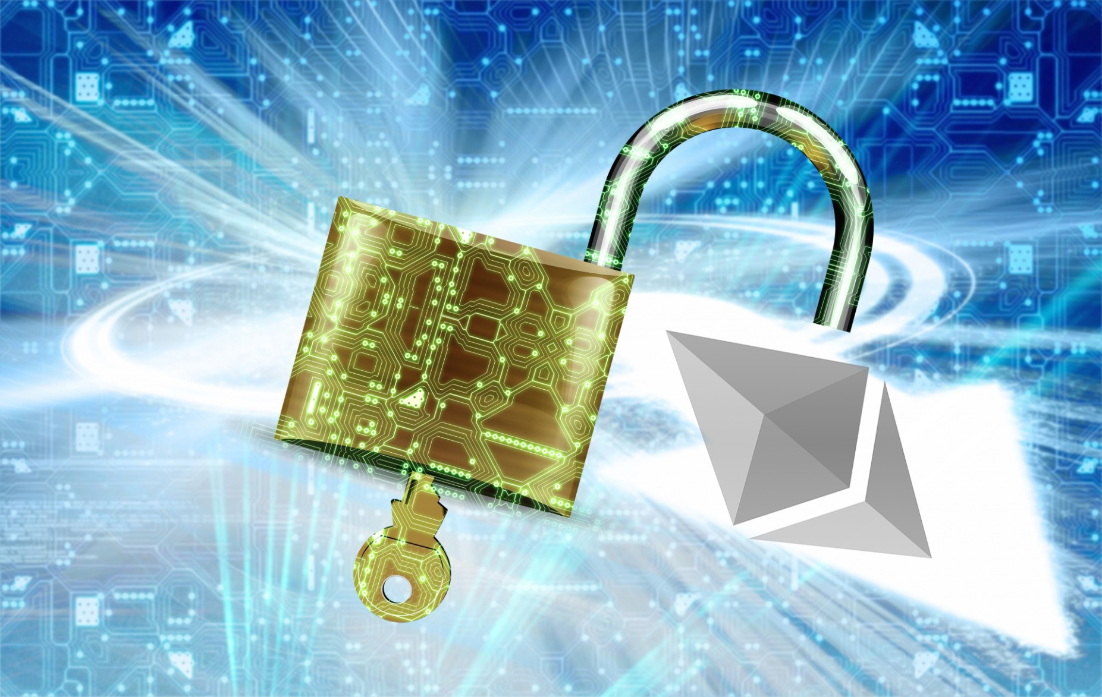
Securing Your Wallet
Careful with online services
Small amounts
Backup wallet
Encrypt online backups
Use many secure locations
Regular backups
Encrypt your wallet
Never forget password
Strong password
Offline wallet for savings
Keep software up to date
Multi-signature
Testament

Slide 23
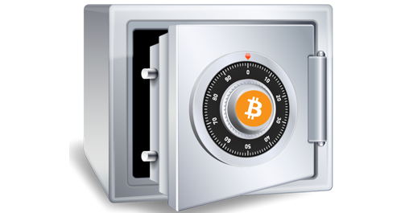
Cold Storage
Keeping crypto offline
Security precaution
Dealing with large amounts
Example
Exchange instant withdrawal feature
Minimize the possibility - stealing entire reserve in a security breach
Amount
Keeping majority in cold storage
Cover anticipated withdrawals - kept on the server

Slide 24
Cold Storage Problems
Secret/private keys and/or backup seeds can be lost
Written on a piece of paper
Printed on a piece of paper
On Laminated paper
Engraved / etched/ ablated/ stamped on a piece of metal
On a computer
On CD, floppy disk, laserdisc, or mini-disc
On a flash drive
Deep cold storage

Slide 25
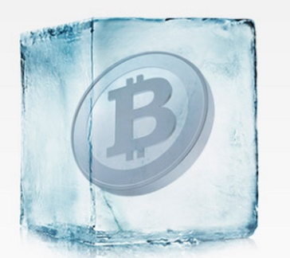
Cold Wallets
Generates and stores private wallet keys offline
Unsigned transactions are generated online
Transferred offline for verification and signing
Signed transaction is transferred online
Funds managed offline in Cold storage
Security precaution
Dealing with large amounts
Protected against online threats
Viruses / trojans / hackers
Similar to hardware wallets

Slide 26

Protect Cryptocurrencies
Hard and long password
Two-factor authentication (2FA)
Diversify: split your funds in several locations
Keep cryptocurrency off the internet
Decentralized exchanges
Do not hold user’s funds

Slide 27
Two Factor Authentication (2FA)
Time-based One-time Password (TOTP)
Most commonly used 2FA
One-time generated code is entered
Identity verified – shared secret
Same hash (HMAC) generated by the two sides
Secret can be exposed during the registration
Universal Second Factor (U2F)
No shared secret
Public key cryptography
Server knows the public key
User knows the private key
No confidential databases stored by the server
Potential attacks against individual users

Slide 28
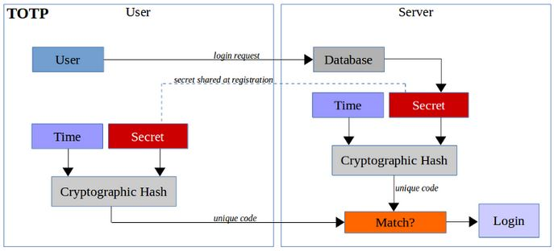
Two Factor Authentication: TOTP Scheme

Slide 29
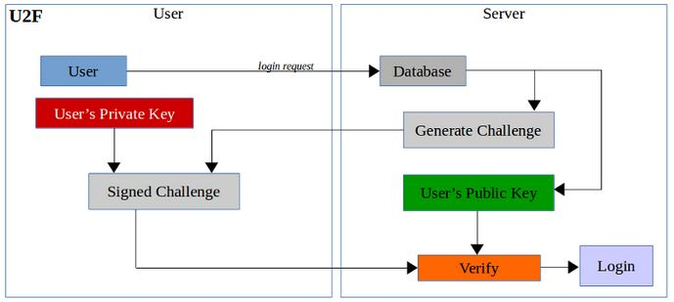
Two Factor Authentication: U2F Scheme

Slide 30
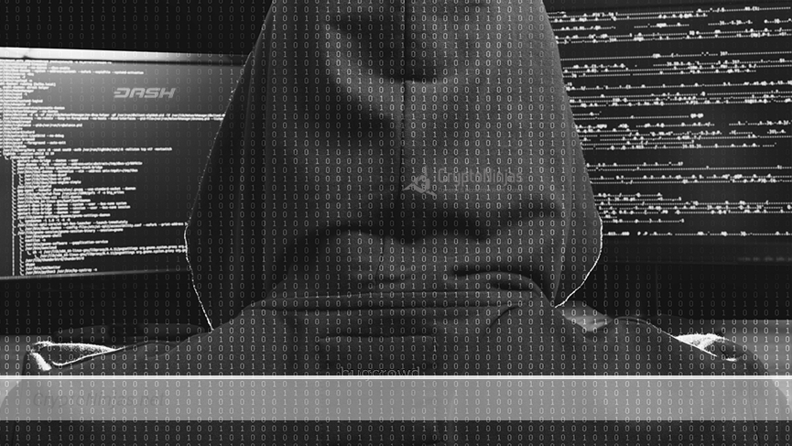
Blockchain Threats
Bitcoin miner malware
Stolen value stores
Transfer trojans
Implementation weaknesses
Known plaintext crib attacks
Weak SHA-256
Sites get hacked
Large, public blockchains are inherently more secure

Slide 31

Server-Side Security
Never Store Private Keys on the Server!

Slide 32
Server-Side Security for Crypto Projects
Assume your server might be hacked soon or later
External attack: hackers, exploits in third party components, etc.
Internal attack: developers and admins already have access
Design the system so that hacker cannot steal money
Cold wallet → holds most of the crypto-assets (e.g. > 99%)
Hot wallet → holds operational funds (e.g. < 1%)
Use multi-signature schemes to send payments
Use smart contracts to collect payments and sign them offline

Slide 33

Server-Side Security: Bad Practice
A server-side component holds the server wallet's private key
The server wallet holds all the funds for the entire system
Very bad idea!
Hacker / developer / admin takes the key
All funds controlled by the key are theft
Example: CoinCheck

Slide 34

Server-Side Security: Good Practice
A server-side component holds a limited power private key
The associated address holds small balance (to pay the gas price)
It can prepare & sign transactions for further processing
Prepared transactions hold proof coming from the client-side
A few other machines verify the prepared transactions
Then multi-signatures are created with hardware wallets
If the hacker / developer / admin takes the key
Funds cannot be theft, only fake transaction can be created

Slide 35
Multi-Signature Wallets
Multi-signature wallets
To sign a transaction, several signatures are required
First signature created at the server-side
Second signature, created at the client side
To send a transaction, both server + client should cooperate
Hackers need to hack the server + the client in the same time
Implementation in Bitcoin:
BIP-45 - Deterministic P2SH Multisignature Wallets

Slide 36

Famous Blockchain Disasters
The DAO Hack, Parity Hacks, Tether Token Hack, Bitcoin Gold Scam, etc.

Slide 37

The DAO Hack
Decentralized Autonomous Organization
Codify the rules and decision making apparatus
Eliminating the need for documents and people in governing
Here’s how it works:
Run the organization by smart contracts
Initial funding period
After ICO, the DAO begins to operate
Make proposals to the DAO
How to spend the money
People with tokens can vote to approve proposals

Slide 38
The DAO Hack Explanation
Call the function splitDAO()
Member will supply some of their own code with the transaction
Code tell the DAO code how to transfer Ethereum coin
Ethereum code is recursive
When splitDAO() is called
Call the recipients code to transfer Ethereum coin
Recipients code will call splitDAO() again before finishing
Process repeat itself
Calling splitDAO() again → calls the hacker's code → calls splitDAO() → calls the hacker's code and so on
Continue endlessly until it drains all of TheDAO's coin

Slide 39
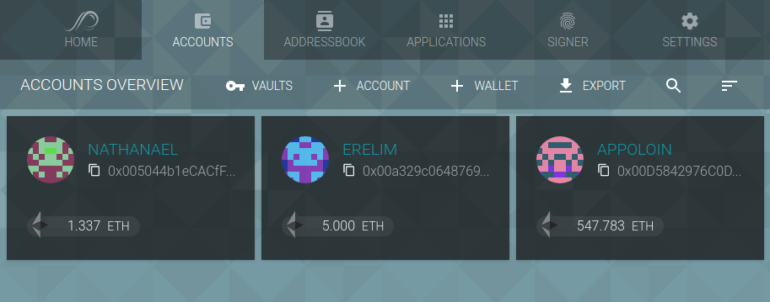
Parity Wallet
Parity wallet offers multiple options to store tokens and Ether
Simple public/private key-pairs
Smart contracts which manage assets
Wallets are controlled by code
Multi-signature wallets - allow for transaction logging, withdrawal limits, and rule-sets for signatures required

Slide 40
First Parity Multisig Hack Wallet Explanation
Attacker First Transaction
Constructor - just pass on the owner array to the multiowned and the limit to daylimit
Attacker Second Transaction
function() payable {
if (msg.value > 0) {
Deposit(msg.sender, msg.value);
} else if (msg.data.length > 0) {
_walletLibrary.delegatecall(msg.data);
}
}
function initWallet(address[] _owners, uint _required, uint _daylimit) { initDaylimit(_daylimit); initMultiowned(_owners, _required); }

Slide 41

First Parity Multisig Hack Wallet Solution
Not extracting the constructor logic into the library contract altogether
Not using delegatecall as a catch-all forwarding mechanism

Slide 42

Second Parity Multisig Hack Wallet Explanation
Parity’s multisig wallet
Lightweight contract
“Library” - all other parity’s multisig wallets depend on this contract
Done to reduce gas usage
function kill(address _to) onlymanyowners(sha3(msg.data)) external { suicide(_to); }

Slide 43

CoinDash ICO Hack
Payment and shipment startup
Ethereum address compromised
Raised $7.3 million
Hacker changed the address
Raising amount of stolen funds from $7 million to $10 million

Slide 44

Enigma Project Scam
Compromised
Website
Mailing lists
Administrator account
Fake token pre-sale
Defrauding potential investors of more than 1,500 ethers
The hijacked accounts promised a large return on investment
Funds were not recovered

Slide 45

Tether Token Hack
Dollar-pegged cryptocurrency Tether
$30+ million was stolen from the U.S
Tokens were taken from their virtual treasury
Sent to an unknown bitcoin address
Company moved to blacklist the tokens stolen through an update to the Omni protocol

Slide 46
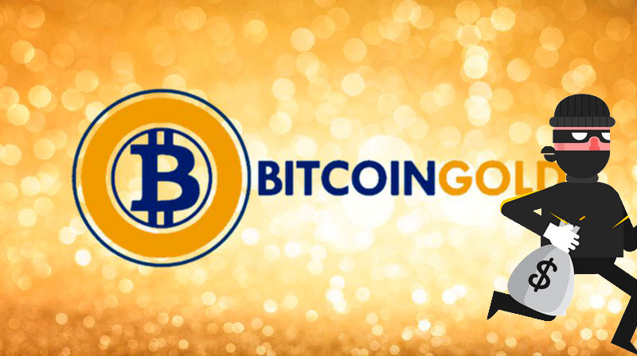
Bitcoin Gold Scam?
Wallets drained
Website’s operators
Stole $3+ million in bitcoin, bitcoin gold, ethereum and litecoin
No relationship with Bitcoin gold’s development team
Initially claimed the site was hacked
Wiped his GitHub
Ceased responding to users on Slack channel

Slide 47
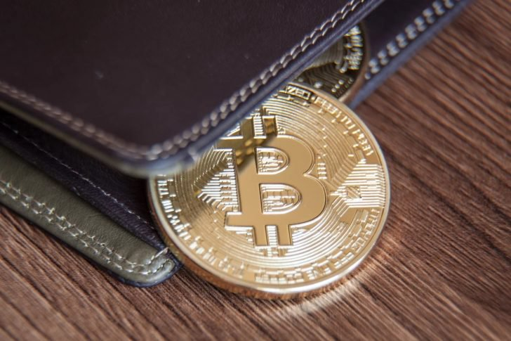
NiceHash Market Breach
NiceHash - cryptocurrency mining marketplace
About 4,700 bitcoin stolen
Employee’s computer -compromised
Perpetrator gain access
Remove bitcoin

Slide 48
Coincheck Exchange Hack
Japanese exchange Coincheck was hacked in Jan 2018
http://fortune.com/2018/01/31/coincheck-hack-how/
Nearly $500 million stolen
All assets were in hot wallet (connected to Internet machine)
No multi-signature was used for the hacked hot wallet
Just steal the private key and transfer the assets to hacker's address

Slide 49

Smart Contract Security
Security Recommendations, Known Attacks, Security Tools

Slide 50
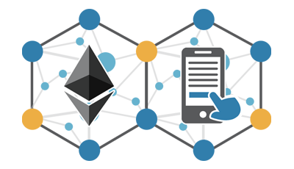
Smart Contracts Security
“Everyone here is a target for attack. Be paranoid.” Martin Swende (Ethereum Foundation security lead)
Ethereum's virtual machine has been improved
Formal verification has been added
Uses math proofs
Solidity has matured
Many mistakes are corrected

Slide 51
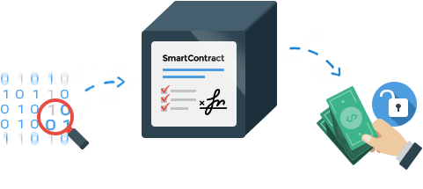
Smart Contracts Security (2)
Smart contract programming requires different engineering mindset
The cost of failure can be high
Change can be difficult - similar to hardware programming
New philosophy of development

Slide 52

Smart Contracts Best Practices General Philosophy
Prepare for failure
Rollout carefully
Keep contracts simple
Stay up to date
Be aware of blockchain properties
Fundamental Tradeoffs: Simplicity versus Complexity cases
Rigid versus Upgradeable
Monolithic versus Modular
Duplication versus Reuse

Slide 53
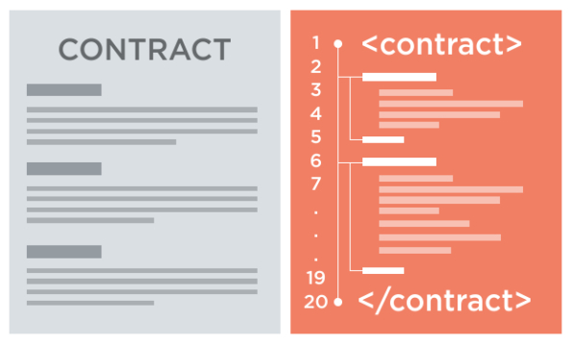
Proper Documentations and Procedures
Specifications and Rollout Plans
Understand what the system is intended to do
Status
Compiler versions
Flags
Known Issues
Key risks with contract
Known bugs/limitations
History
Testing
Procedures
In case a bug is discovered
Contact Information

Slide 54

Smart Contracts Security Tools
Static Analysis
Manticore
Mythril
Oyente
Solgraph
Linters
Solcheck
Solint
Solium
Solhint
Test Coverage
solidity-coverage

Slide 55

Smart Contracts Security Notifications
The official Ethereum blog: Ethereum Blog
All blog posts that are tagged Security: Ethereum Blog - Security only
Chat rooms:
Ethereum Gitter
Solidity
Go-Ethereum
CPP-Ethereum
Research
Reddit
Ethereum Stats: Network Stats

Slide 56

Structure of Smart Contract Audit
Disclaimer
Overview of the audit and nice features
Attacks made to the contract
Critical vulnerabilities found in the contract
Medium vulnerabilities found in the contract
Low severity vulnerabilities found
Line by line comments
Summary of the audit

Slide 57

Live Demo
Formal Verification of Smart Contracts
https://securify.ch/

Slide 58
ERC20 Short Attack
Invoke the transfer(address a, uint v) method
Transfer 1 GNT to address 0xabcabcabcabcabcabcabcabcabcabcabcabcabca needs to include 3 pieces of data:
Method id - 4 bytes: a9059cbb
Destination address (20 bytes) with leading zeros - 32 bytes: 000000000000000000000000abcabcabcabcabcabcabcabcabcabcabcabcabca
Value to transfer (1 * 10¹⁸ GNT) - 32 bytes: 0000000000000000000000000000000000000000000000000de0b6b3a7640000
Full transaction : a9059cbb000000000000000000000000abcabcabcabcabcabcabcabcabcabcabcabcabca0000000000000000000000000000000000000000000000000de0b6b3a7640000

Slide 59
ERC20 Short Attack (2)
Construct Attack
Have 1,000 tokens
Would like 256,000
Generate an Ethereum address with a trailing 0 (256 tries)
Find an exchange wallet with 256,000 tokens
Send 1,000 tokens to this wallet
Request a withdrawal of 1,000 tokens
Fixes
Check address validity in-band
Including throwing for data underflows
Check user input for full 20 bytes address
Transfer function could check that len(msg.data) is 68 bytes
OnlyPayloadSize modifier

Slide 60

Exercise: Reentrancy Attack on a Smart Contract
Deploy Smart Contract and Hack it

Slide 61

Summary
Vectors of attack – cryptography, networking, consensus, wallets and keys, 2FA, phishing and scam, server hacks, smart contracts
Blockchain – each block connected to blocks before and after and secured through cryptography
Wallets – careful with online services, backup, use hardware
Exchanges – decentralized, 2FA, diversify
Blockchain's disasters – The DAO Hack, Parity Wallet Breach and Freeze, CoinDash ICO Hack, Enigma Project Scam, Tether Token Hack, Bitcoin Gold Scam, NiceHash Market Breach, Coincheck

Slide 62
Blockchain Security
http://www.kingsland.academy

Slide 63
Resources
Security by the Blocks: https://www.ibm.com/blogs/blockchain/2017/12/blockchain-security-what-keeps-your-transaction-data-safe/
Uses of Blockchain Security: http://www.businessinsider.com/secure-cryptocurrency-blockchain-technology-2017-10
Proper Documentations and Procedures: https://consensys.github.io/smart-contract-best-practices/documentation_procedures/
The DAO Hack: https://steemit.com/ethereum/@jpbeaudet/ethereum-thedao-hack-explained
First Parity Multisig Wallet Attack: https://blog.zeppelin.solutions/on-the-parity-wallet-multisig-hack-405a8c12e8f7
Only As Secure As: https://cryptopotato.com/9-must-tips-securing-crypto-wallet/

Slide 64
Resources (2)
Second Parity Multisig Wallet Attack: https://medium.com/@Pr0Ger/another-parity-wallet-hack-explained-847ca46a2e1c
Wallet’s Security: https://blockchain.info/wallet/security
Secure your Wallet: https://bitcoin.org/en/secure-your-wallet
Hacks: https://www.coindesk.com/hacks-scams-attacks-blockchains-biggest-2017-disasters/
Blockchain Threats: https://www.csoonline.com/article/3241121/cyber-attacks-espionage/hacking-bitcoin-and-blockchain.html
Cold Wallets: https://en.bitcoin.it/w/index.php?title=Securing_your_wallet&redirect=no#Cold_wallets
Cold Storage: https://en.bitcoin.it/wiki/Cold_storage
Protect Cryptocurrencies: https://www.cnbc.com/2017/11/02/heres-how-to-protect-your-bitcoin-and-ethereum-from-hacking.html

Slide 65
Resources (3)
ECDSA attacks: http://blog.bettercrypto.com/?p=916
Side-channel attack: https://en.wikipedia.org/wiki/Side-channel_attack
Cryptography Attacks: https://www.tutorialspoint.com/cryptography/attacks_on_cryptosystems.htm
Collision (hash functions) attack: https://en.wikipedia.org/wiki/Collision_attack
Quantum Computing: https://www.forbes.com/sites/amycastor/2017/08/25/why-quantum-computings-threat-to-bitcoin-and-blockchain-is-a-long-way-off/
51% Attack: https://www.investopedia.com/terms/1/51-attack.asp
Attack Blockchain Network: https://en.bitcoin.it/wiki/Weaknesses
Timejacking: http://culubas.blogspot.bg/2011/05/timejacking-bitcoin_802.html
Attacking the Wallets: https://www.tokenverse.com/blog/wallets-exchanges-and-attack-vectors-how-should-you-store-your-crypto-assets/

